Slide 1
EMPLOYEE DATA ANALYSIS USING EXCEL
STuDENT NAME: SENTHAMIZH SELVAN register no : asunm110312201177 Department : department of BANK MANAGEMENT college : d.r.b.c.c.c.hindu college

Slide 2
Project title
EMPLOYEE DATA ANALYSIS USING EXCEL

Slide 3
Agenda:
Problem Statement
Project Overview
End Users
Our solution and Proposition
Dataset Description
Modelling Approach
Result and Discussion
Conclusion

Slide 4

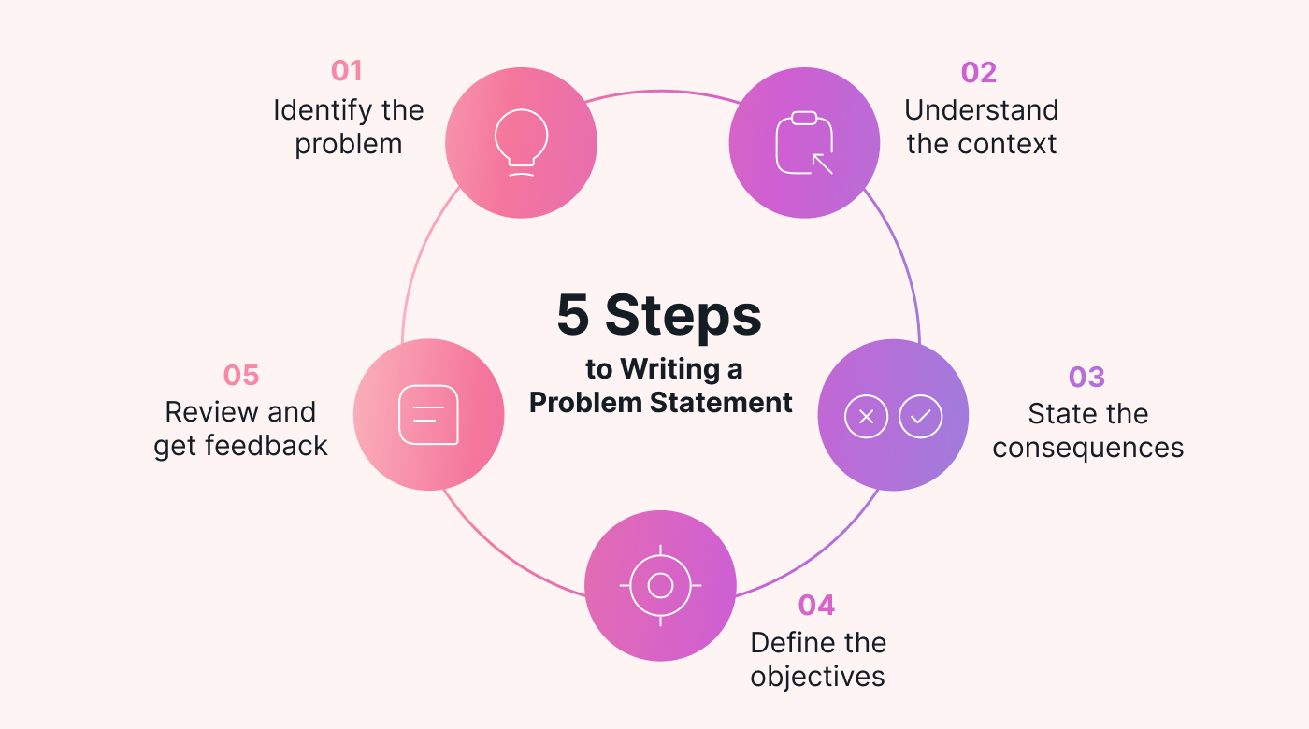
Problem statement
The problem statement should address not only what the problem is, but why it's a problem and why it's important to solve it. This will wrap the other 'W' questions in organically, in most cases.

Slide 5
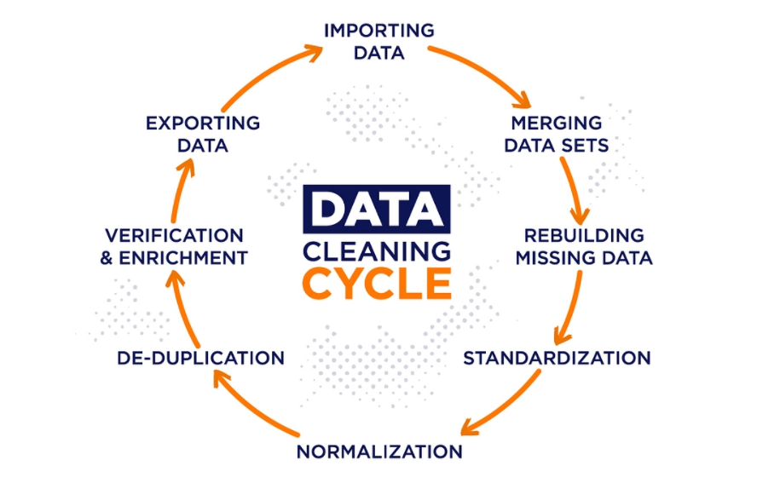
Project overview

Slide 6
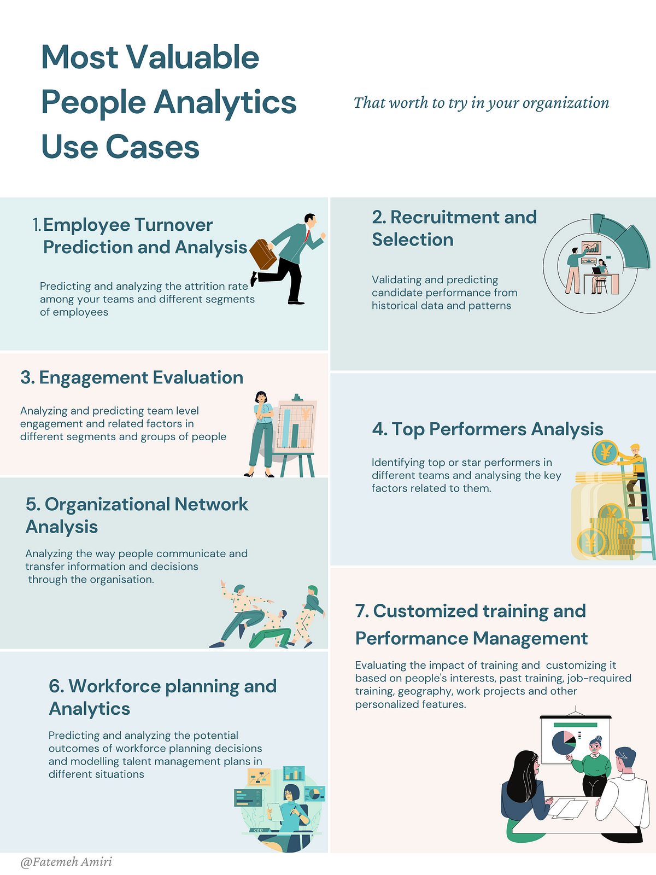
End users

Slide 7
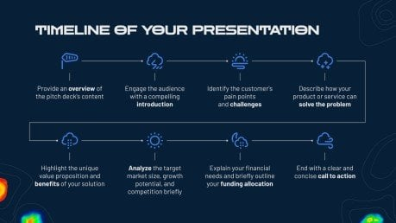
Our solutions and propositions

Slide 8
Data description
Employee data description:
EMP ID | NAME | JOB TYPE | Salary
PR00210 | Dare Tully | Accountant | 15000
PR00211 | Bari Toffano | Product Manager | 32000
PR00212 | Richy Gray | Business Development | 45000
PR00213 | Michale Rolf | Service | 45000
PR00214 | Katya Hundy | Business Development | 45000
PR00215 | Alicea Pudsall | Product Manager | 45000
PR00216 | Marline | Sales | 45000
PR00217 | David | Marketing | 50000
PR00218 | Danica Nayshe | Business Development | 45500
PR00219 | Natalee Craaiker | Product Manager | 25500

Slide 9
Data set description
A Dataset is a set or collection of data. This set is normally presented in a tabular pattern. Every column describes a particular variable. And each row corresponds to a given member of the data set, as per the given question. This is a part of data management.
the highest level, there are two kinds of data: quantitative and qualitative. These two types of data break down further into four classifications. The two subcategories of qualitative data are nominal data and ordinal data.

Slide 10
Modelling approach
I get data from dashboard employee data analysis. And brief about the problem statement and project overview what to do and accurate information about the projectoverwview.And end users are where it was started and where it was ended ..our solution and prospostion are solution the project . It is the profit motivate and satisfied the employee wants and needs .

Slide 11
Results and discussion
Result in excel
EMP ID | NAME | JOB TYPE | Salary
PR00210 | Dare Tully | Accountant | 15000
PR00211 | Bari Toffano | Product Manager | 32000
PR00212 | Richy Gray | Business Development | 45000
PR00213 | Michale Rolf | Service | 45000
PR00214 | Katya Hundy | Business Development | 45000
PR00215 | Alicea Pudsall | Product Manager | 45000
PR00216 | Marline | Sales | 45000
PR00217 | David | Marketing | 50000

Slide 12
Conclusion
Now I conclude the presentation Improve hiring and talent acquisition: Data analytics can help recruiters find professionals with the right skills and qualifications.
Employee strengths are important because they can affect performance, motivation, and retention. According to the strengths-based approach, focusing on and developing the strengths of your employees can lead to greater productivity and quality, higher engagement and satisfaction, and lower turnover and absenteeism

Slide 13
Thank you

